Slide 1
Module 2
Chapter 2: The Relational Data Model

Slide 2
History of Relational data Model
Relational data model was first introduced in 1970 by a computer scientist and mathematician. Ted Codd.
In this model he gave a simple way of storing data to as well as retrieving data from rows and columns in a table that is this model is all both organizing data into tables with rows and columns.
Relational data model uses the concept of mathematical relation and theoretically it is based on set theory.
The first commercial implementations of the relational model was by Oracle DBMS and even IBM started to implement the same. SQL/DS System is IBMs first commercial relational database management system.
Current popular RDBMS are the SQL server and access from Microsoft ,DB2 and Informix from IBM etc. SQL query language became the standard language for these commercial RDBMS.

Slide 3
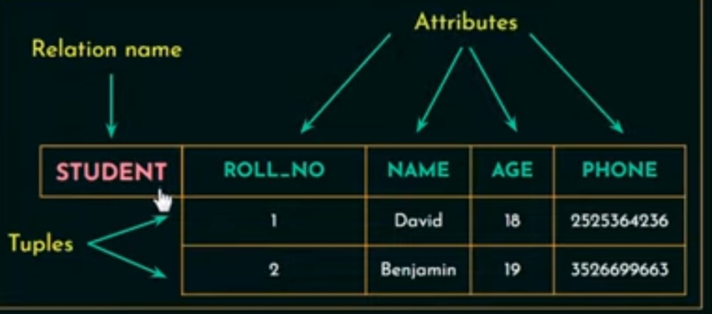
Relational Model Concepts
Relational database model organizes the data in the form of tables or in other words relational model represents data as a collection of tables.
In RDBMS a table is also called a relation.

Slide 4
Here STUDENT is a Relation name or a table name.
Each row are called tuple.
Here we have two tuples or two rows.
Each column or column header are called as attributes or fields.
In this relation student we have four attributes of four columns.

Slide 5
Domain
Domain in mathematics is a set of possible values that you can input.
In Relational database it is a set of atomic values that are allowed for an attribute.
Atomic: Each values in that domain is not divisible further.
Ex: 1) Name : String of characters that represent name of a person.
A set of values to the attribute name should be a string of characters that represent the name of person.
2) Employee_ages: Possible ages of employees of a company (Values between 20 and 70 years old).
Domine not only gives set of values that are allowed for a attributes it also specifies the data type allowed.
Ex: Age has to be a positive integer.

Slide 6
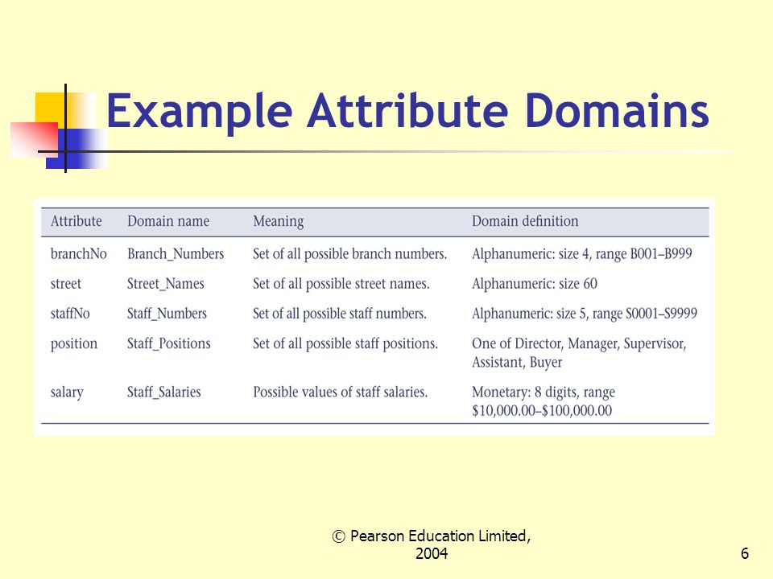

Slide 7
Attribute
Represents a property or characteristic of an entity. Corresponds to a column in a database table.
Examples: EmployeeID, Name, DateOfBirth, Salary.
Domain
Defines the set of possible values that an attribute can take. Essentially, it specifies the data type and constraints for an attribute.
Examples: The domain of EmployeeID might be a set of positive integers.
The domain of DateOfBirth might be a set of valid dates. The domain of Salary might be a set of valid numbers

Slide 8

Relation schema
Relation schema is used to describes a relation or a table.
A relation schema is made up of a relation name R and a list of attributes A1 ,A2 ,A3,………….,An.
Relation schema can also be written, by including the data types.

Slide 9
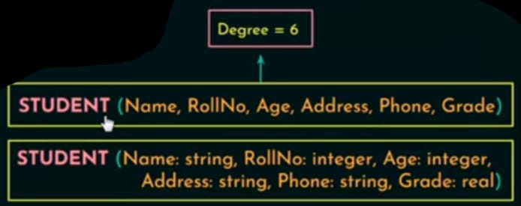
Degree ( or arity) of a Relation
It is defined as a number of attributes in a relation schema.

Slide 10
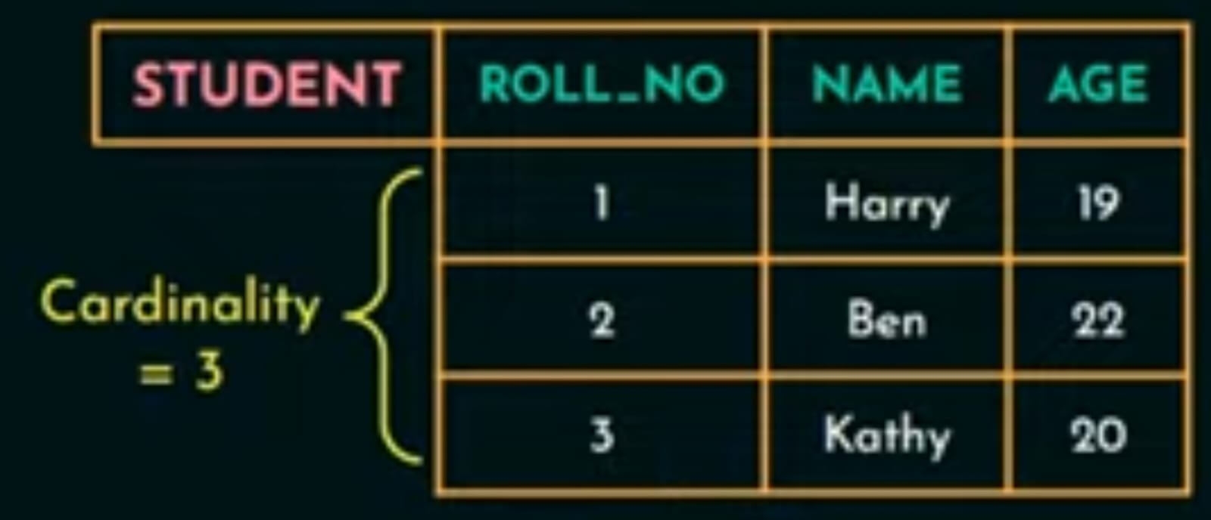
Cardinality
Total number of tuples or rows present in a relation.
Relation state (or relation database instance)
Relation state is a set of tuples at a given time

Slide 11
Relational database schema
It is a set of relation schemas and a set of integrity constraints.
If I consider Company database the relational database schema of that company would have the collection of relation schemas like employee relational schema like employee details the department relation schema the project relational schema etc.
Collection of all these relational schema with all the integrity constraints make up the relational database schema for a company database.

Slide 12
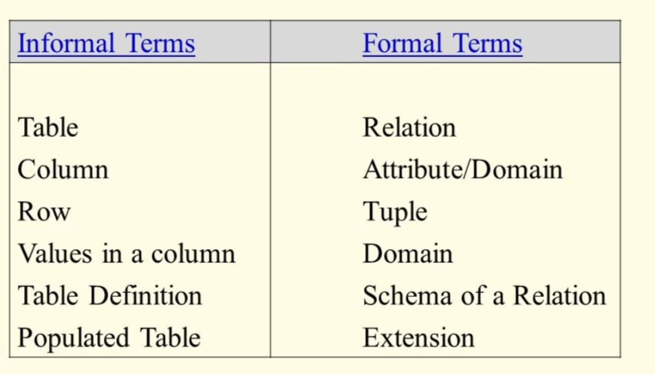

Slide 13
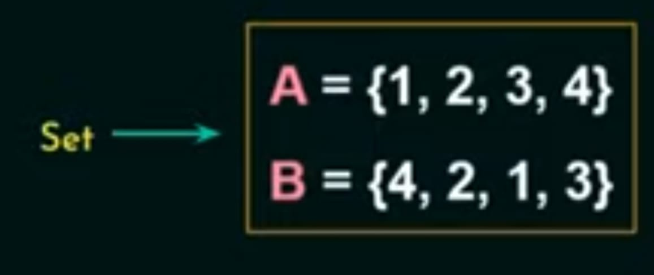
Characteristics of relations
Ordering of tuples within a Relation
A relation or a table is a set of tuples or rows.
Mathematically the elements in a set don’t follow any order and theoretically relational databases were based on set theory. Therefore elements in the set need not fallow any order.

Slide 14
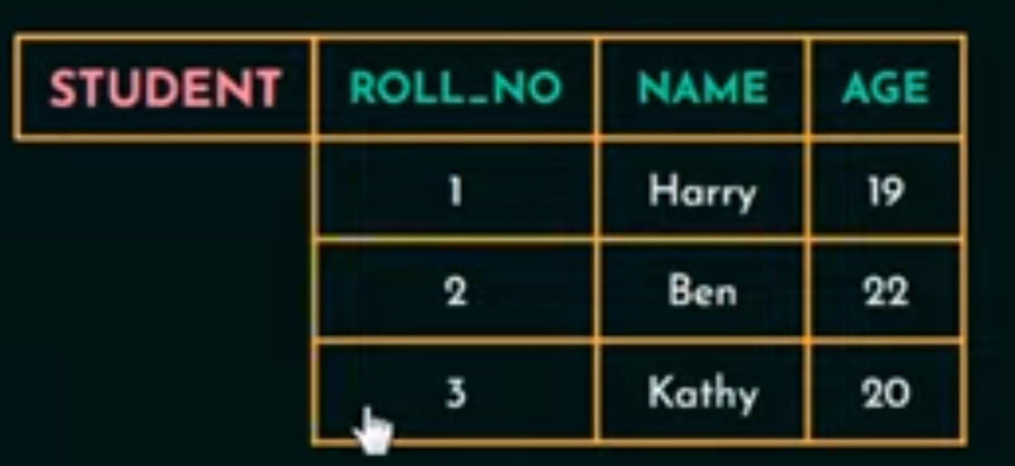
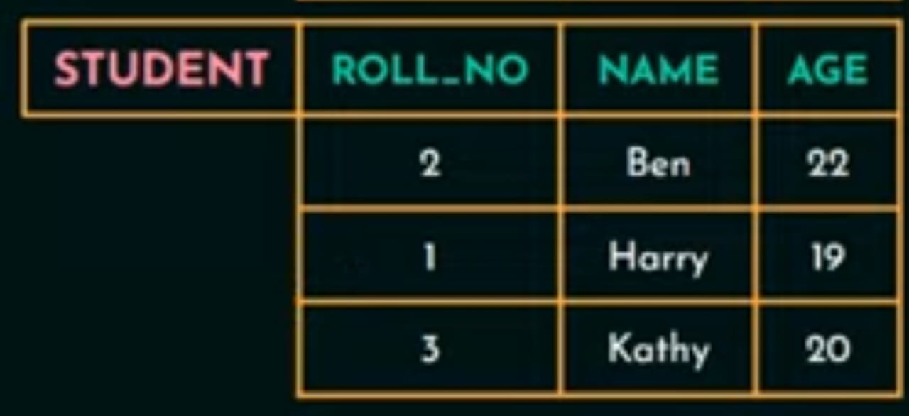
The tuples in a relation need not have any particular order.

Slide 15
But when it comes to files all the records are physically stored on disk or in the memory and since its physically stored it would be good to have an order among the record like first record second record so on. This help in searching and retrieving records faster.

Slide 16
Ordering of values within a Tuple
An n-tuple is an ordered list of n values, so ordering of values in a tuple is important.

Slide 17
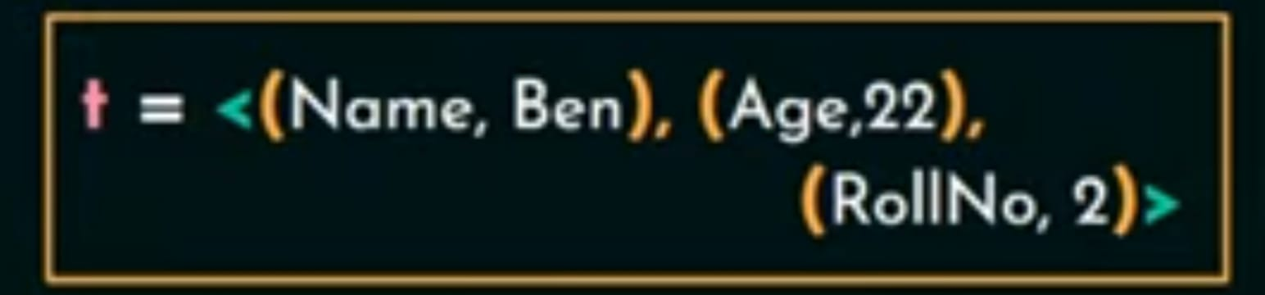
With an alternative definition of relation, ordering of values in a tuple is unnecessary.
A tuple is defined as a set of (<attributes>,<values>) pair, then ordering of attribute is not important because the attribute name and the corresponding values is mention together .

Slide 18
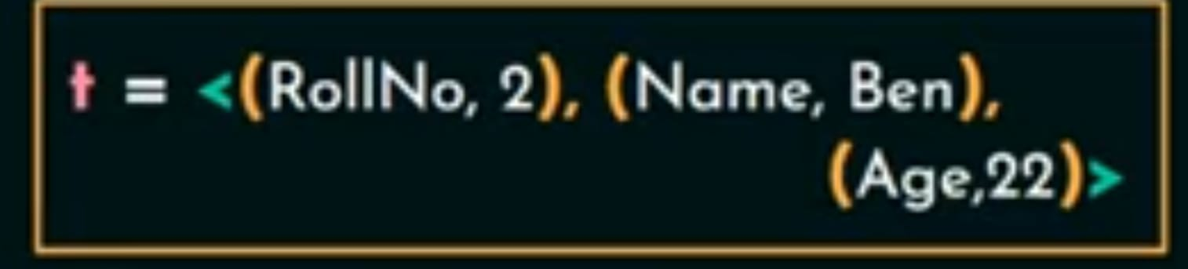
Even if we will change the order of these pairs as given over here the meaning will not change.
But in RDBMS we use relation or table to store the data ordering of values within a tuple is important.

Slide 19
Values and Null in Tuple
Each value in tuple is a atomic value(that is it has to be a value that cannot be divided further).
Since the values has to be atomic we cannot have composite or multivalued attribute in RDBMS and because of that it is called as flat relation model.

Slide 20


In RDBMS or in relational databases these multivalued attribute should be represented by separate relations or separate tables .

Slide 21
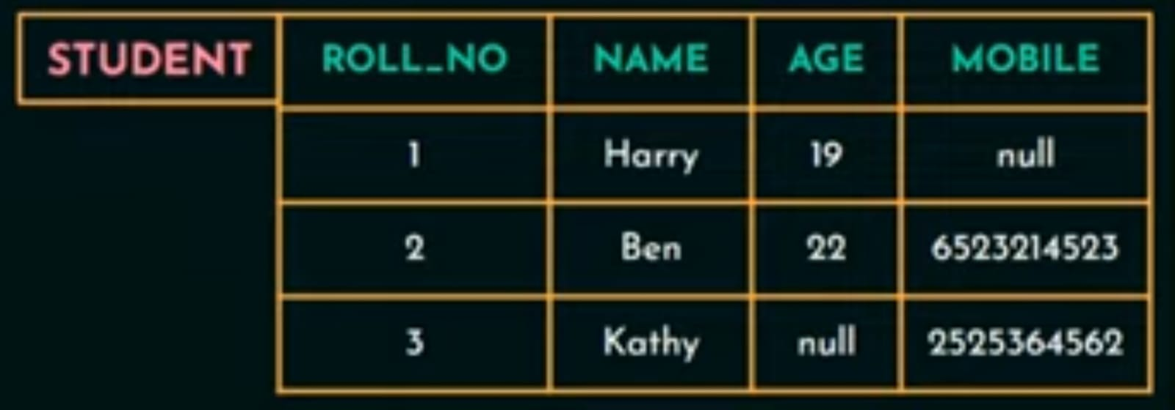
Null values can be used when the values are unknow or when the value exists but it is not available or when the value is not applicable to that particular tuple.

Slide 22

Interpretation of a relation
The Relation schema can be represented as a declaration or assertion.
These relation schema declares or asserts that each student entity has a roll number, name ,age and a mobile number.

Slide 23
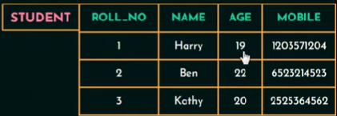
Each tuple in relation trying to declare something about the student and each tuple can be interpreted as a fact .
for example the first tuple in the relation student declares a fact that a student named harry whose roll number is 1 age is 19.
Relation represent facts about entities and relationship.

Slide 24
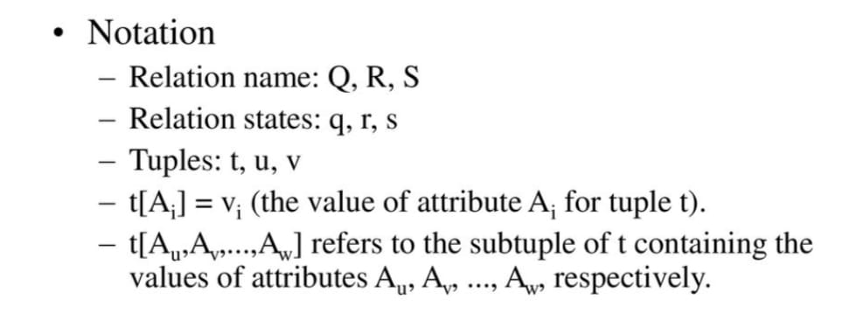

Slide 25
Relational Model Notation
Relation schema R of degree n is denoted by by R(A1, A2, ...,An)
Uppercase letters Q, R, S denote relation names
Lowercase letters q, r, s denote relation states
Letters t, u, v dénote tuples
In general, the name of a relation schema such as STUDENT also indicates the current set of tuples in that relation
An attribute A can be qualified with the relation name R to which it belongs by using the dot notation R.A for example, STUDENT.Name or STUDENT.Age.

Slide 26
Relational Model Notation
An n-tuple t in a relation r(R) is denoted by t = <v1, v2, ..., vn>, where vi is the value corresponding to attribute Ai. The following notation refers to component values of tuples:
Both t[Ai] and t.Ai (and sometimes t[i]) refer to the value vi in t for attribute Ai.
Both t[Au, Aw, ..., Az] and t.(Au, Aw, ..., Az), where Au, Aw, ..., Az is a list of attributes from R,
refer to the sub tuple of values <vu, vw, ..., vz> from t corresponding to the attributes specified in the list.

Slide 27
Relational Model Constraints
Constraints are restrictions on the actual values in a database state.
Constraints on databases can generally be divided into three main categories:
Inherent model-based constraints or implicit constraints
Constraints that are inherent in the data model.(this constraint are inherent or already exits in the data model.)
For example, the constraint that a relation cannot have duplicate tuples is an inherent constraint.

Slide 28
2. Schema-based constraints or explicit constraints
Defined directly in the schemas of the data model.
Ex: Age of the employee has to be between 22 to 65 years. here age is restricted to be between 22 to 65.
The schema-based constraints include domain constraints, key constraints, constraints on NULLs, entity integrity constraints, and referential integrity constraints.
3. Application-based or semantic constraints or business rules
Cannot be directly defined in the schemas of the data model,(that’s why it is difficult to express within the data model)
Hence must be expressed and enforced by the application programs.

Slide 29
Schema-Based Constraints
1) Domain Constraints
Domain Constraints specifies that within each tuple the value of each attribute has to be atomic or indivisible.
This constraint checks the data type of the values of each attribute .
Ex: If we are assigning the data type of the attribute age as int then we cant have any values in that column other than int data type.

Slide 30
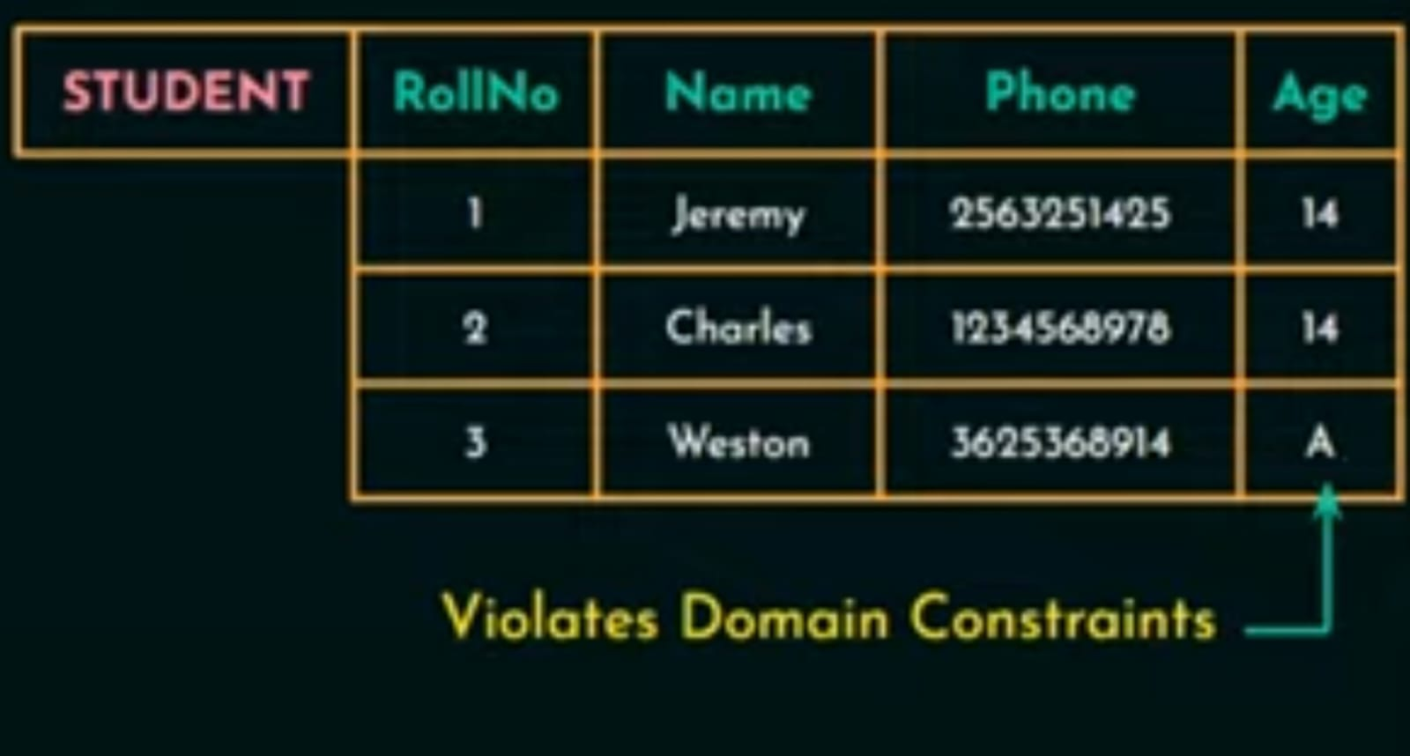

Slide 31
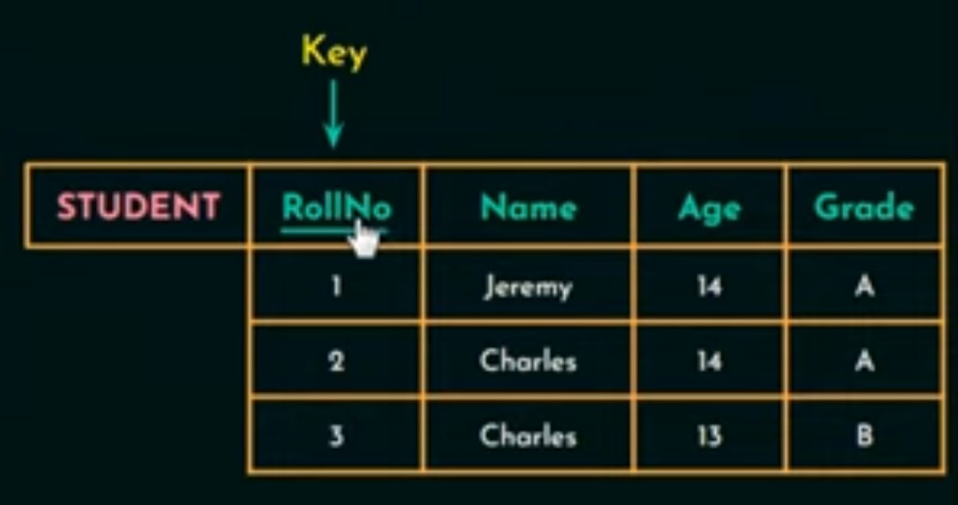
2) Key Constraints
An attribute that can uniquely identify each tuple in a relation is called a Key.

Slide 32

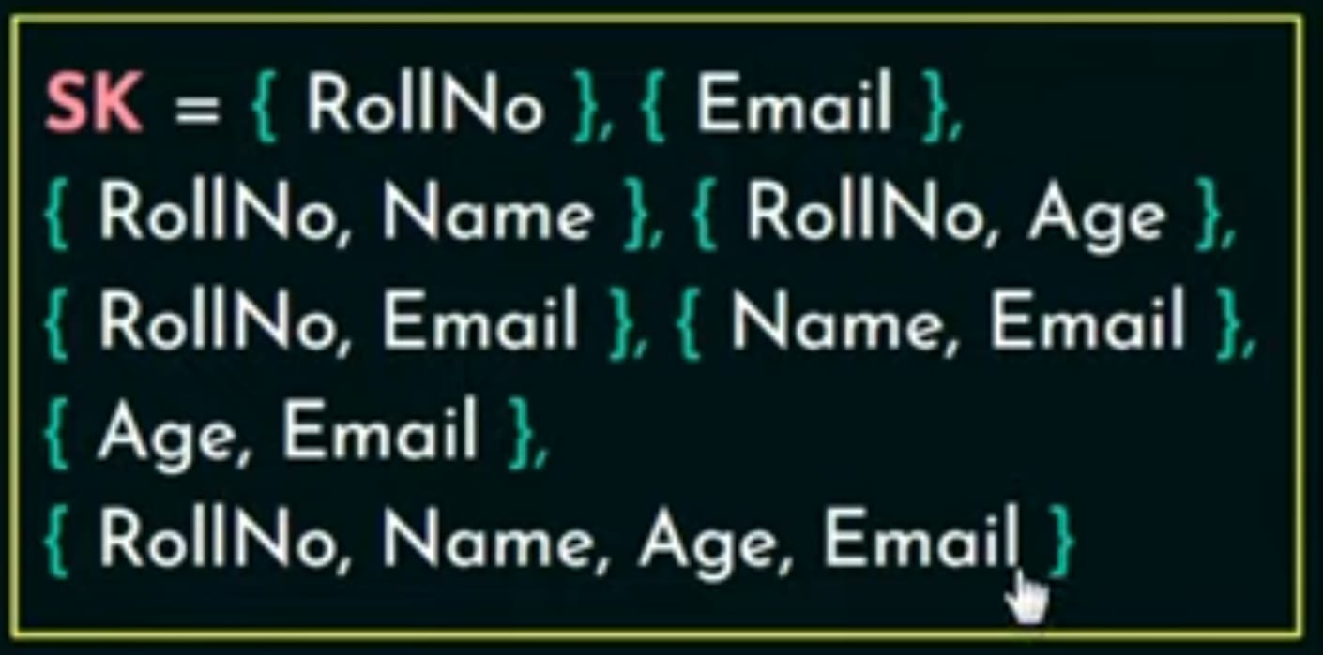
A Super key is set of attribute that can be is identified each tuple in relation uniquely.
A super key specifies that no two tuples can have the same values.
Every relation has at least one super key by default and that super key is a set of all attributes.

Slide 33
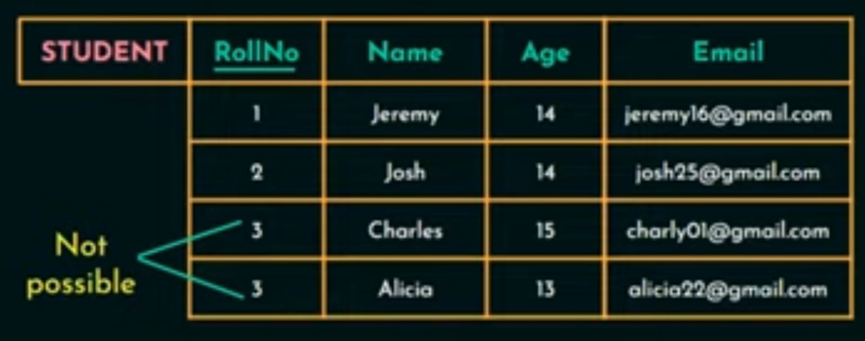
A key satisfies 2 constraints.
Two tuples cannot have identical values for all the attributers in the key.
It has to be a minimum super key
First condition is for both key and super key and second condition is only for keys.

Slide 34
Now the relation schema can have more then one key in that case each of key is called candidate key.
Candidate Key: It is a set of attributes that uniquely identify the tuples in a relation.
Ex: In this relation we have 2 candidate key
roll number.
email.
We can have any number of candidate key in the relation but we designate only one of the candidate key as the primary key of that relation.

Slide 35

3) Constraint on Null values:
Specifies whether null values are permitted or not(NOT NULL).
If we are giving NOT NULL constraint to any of the attribute then value of that attribute cannot be null.
4) Entity Integrity Constraint:
States that no primary key value can be null.

Slide 36
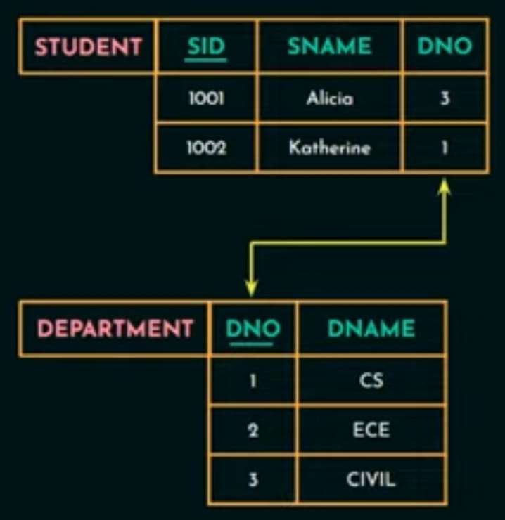
5) Referential integrity Constraint
A key constraint and entity integrity constraint are specified on a single relation or a single table whereas referential integrity constraints is specified between two relation or two table.
It states that refers to another relation must refer to an existing tuple in that relation.

Slide 37
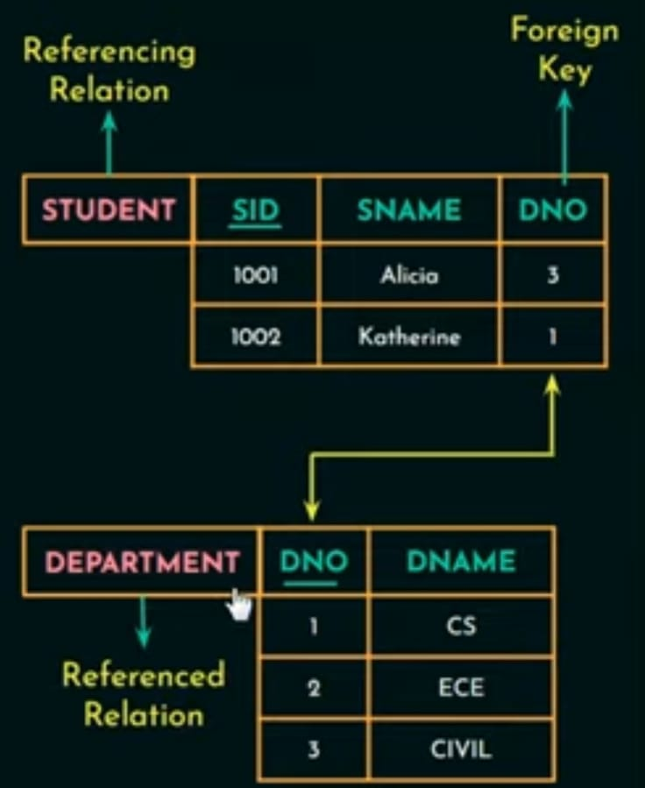

The attribute of one relation that refers to the primary key of another relation is called the foreign key.
Foreign key must satisfy the following:
1)It has to be a same domain as the attributes it refer to.
2)Value of foreign key in a tuple either occurs as a value of Primary key i.e

Slide 38
The operations of the relational model can be categorized into retrievals and updates
There are three basic update operations that can change the states of relations in the database:
1. Insert - used to insert one or more new tuples in a relation
2. Delete- used to delete tuples
3. Update (or Modify)- used to change the values of some attributes in existing tuples.

